Slide 1
Advancing Healthcare Innovation Summit (AHIS) 2023, Virtual Event November 11, 2023
*Deep learning-based segmentation of human epithelial type-2 (HEp-2) cells using indirect immunofluorescence (IIF) images*
Presented By: Balaji Iyer
Notes:
Hello Everybody, first of, I thank the organizers of AHIS for this wonderful conference and this opportunity to present our research work.
The topic of my presentation is “Deep learning-based segmentation of human epithelial type-2 (HEp-2) cells using indirect immunofluorescence (IIF) images”

Slide 2
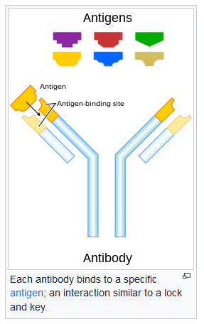
Introduction
Human epithelial type-2 (HEp-2) cell specimens obtained by indirect immunofluorescence (IIF) protocol
Gold standard for detecting Antinuclear Autoantibodies (ANA)
Antibodies: Y-shaped proteins synthesized by plasma cells.
Precisely identify and bind to specific antigens like pathogenic bacteria or virus, aiding in their elimination.
Source: https://en.wikipedia.org/wiki/Antibody
Notes:
Human epithelial type-2 (HEp-2) cell specimens obtained by indirect immunofluorescence (IIF) protocol
Gold standard for detecting Antinuclear Autoantibodies (ANA)
What is an Antibody. Antibodies are Y-shaped proteins synthesized by plasma cells (white blood cells).
Their function is to Precisely identify and bind to specific antigens like pathogenic bacteria or virus, aiding in their elimination.
Each antibody binds to a specific antigen just like a lock and key combination.

Slide 3
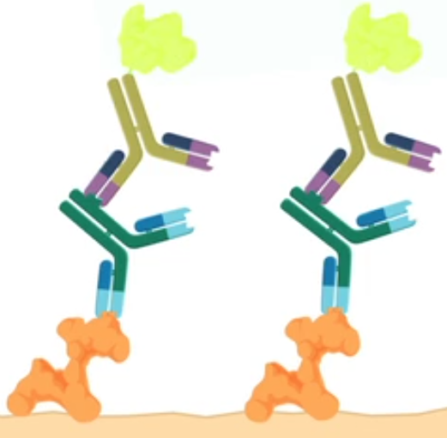
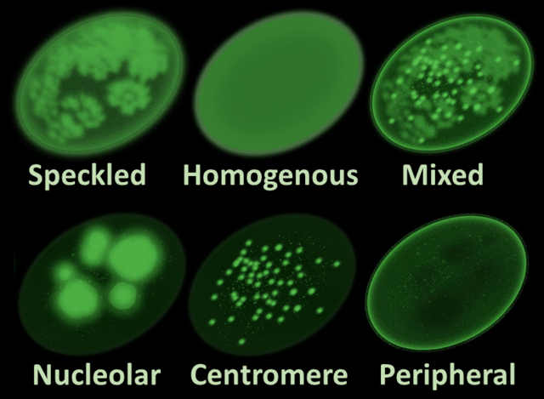
Introduction
Fluroscent Conjugate
Antinuclear Antibodies
In healthy individuals, the antibodies target pathogenic antigens (foreign) but not autoantigens (native)
Antinuclear antibodies (ANA’s) target protein complexes within the cell nucleus.
Prevalence of ANAs indicative of range of disorders: autoimmune diseases, cancer and infection.
ANAs bind to antigens present in the Hep-2 substrate cells. Fluroscent conjugates bind to the antinuclear antibodies.
Different staining patterns are observed based on the antibodies present in the serum.
Typically used for diagnosis of autoimmune diseases such as rheumatoid arthritis, multiple sclerosis etc.
Hep-2 Cell Antigens
Source: https://en.wikipedia.org/wiki/Antinuclear_antibody
Notes:
In healthy individuals, the antibodies target pathogenic antigens (foreign) but not autoantigens (which are synthesized by other cells in the body)
Antinuclear antibodies (ANA’s) target protein complexes within the cell nucleus
Prevalence of ANAs indicative of range of disorders: autoimmune diseases, cancer and infection.
ANAs bind to antigens present in the Hep-2 substrate cells. Fluroscent conjugates bind to the antinuclear antibodies
Different staining patterns are observed depending on the antibodies present in the serum.
This test is Extremely useful for diagnosing autoimmune diseases such as rheumatoid arthritis, multiple sclerosis, type 1 diabetes etc.

Slide 4
Goals & Contributions
In this study, our goal is to develop Deep Learning models for accurate segmentation of HEp-2 cells from IIF images.
Contributions:
Systematic Review: In-depth literature survey of HEp-2 cell segmentation techniques covering classical image processing techniques, machine learning models and state-of-the art deep learning models
Extensive benchmarking and review of CNN models including transformers
Experimental analysis of different model pre-training and data augmentation techniques.
Benchmarking Generative AI frameworks for HEp-2 cell segmentation.
Notes:
In this study, our goal is to develop Deep Learning models for accurate segmentation of HEp-2 cells from IIF images.
Contributions:
Systematic Review: In-depth literature survey of HEp-2 cell segmentation techniques covering classical image processing techniques, machine learning models and state-of-the art deep learning models
Extensive benchmarking and review of CNN models including transformers
Experimental analysis of different model pre-training and data augmentation techniques.
Benchmarking Generative AI frameworks for HEp-2 cell segmentation.

Slide 5
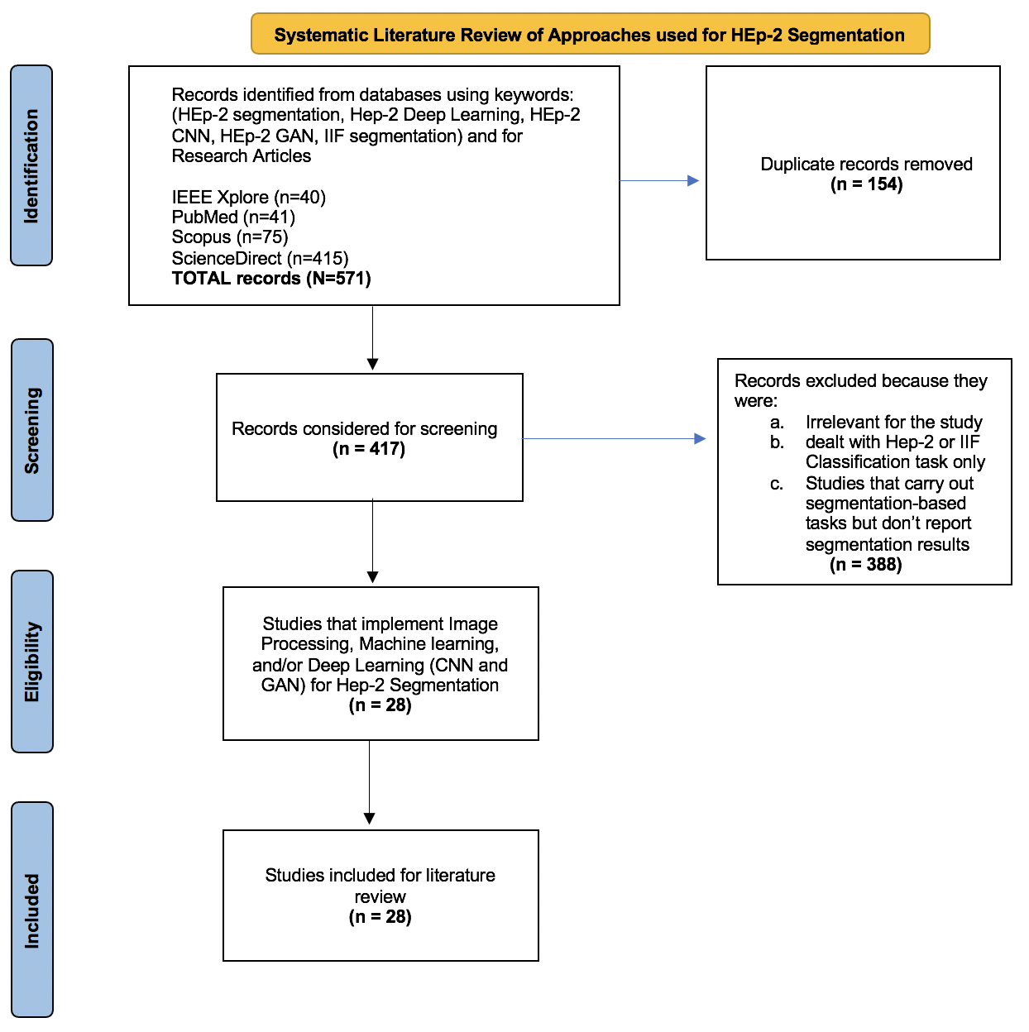
Literature Review
Systematic Review of computer aided HEp-2 cell segmentation from 2008 to 2022.
Nearly 30 research articles reviewed across multiple scientific journals.
In depth discussion of methods and experiments
Extensive discussion of pros and cons of each study.
Notes:
Systematic Review of computer aided HEp-2 cell segmentation from 2008 to 2022.
Nearly 30 research articles reviewed across multiple scientific journals.
In depth discussion of methods and experiments
Extensive discussion of pros and cons of each study.

Slide 6
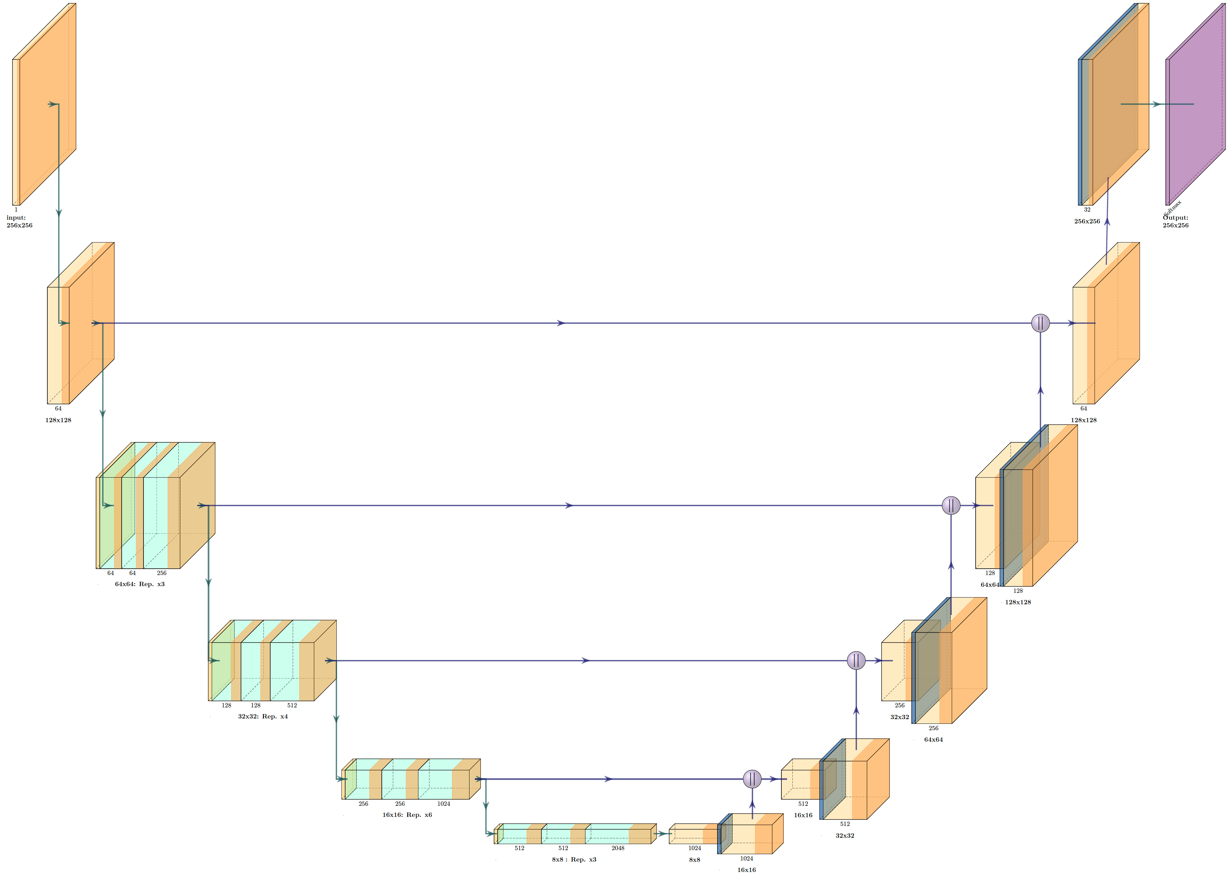
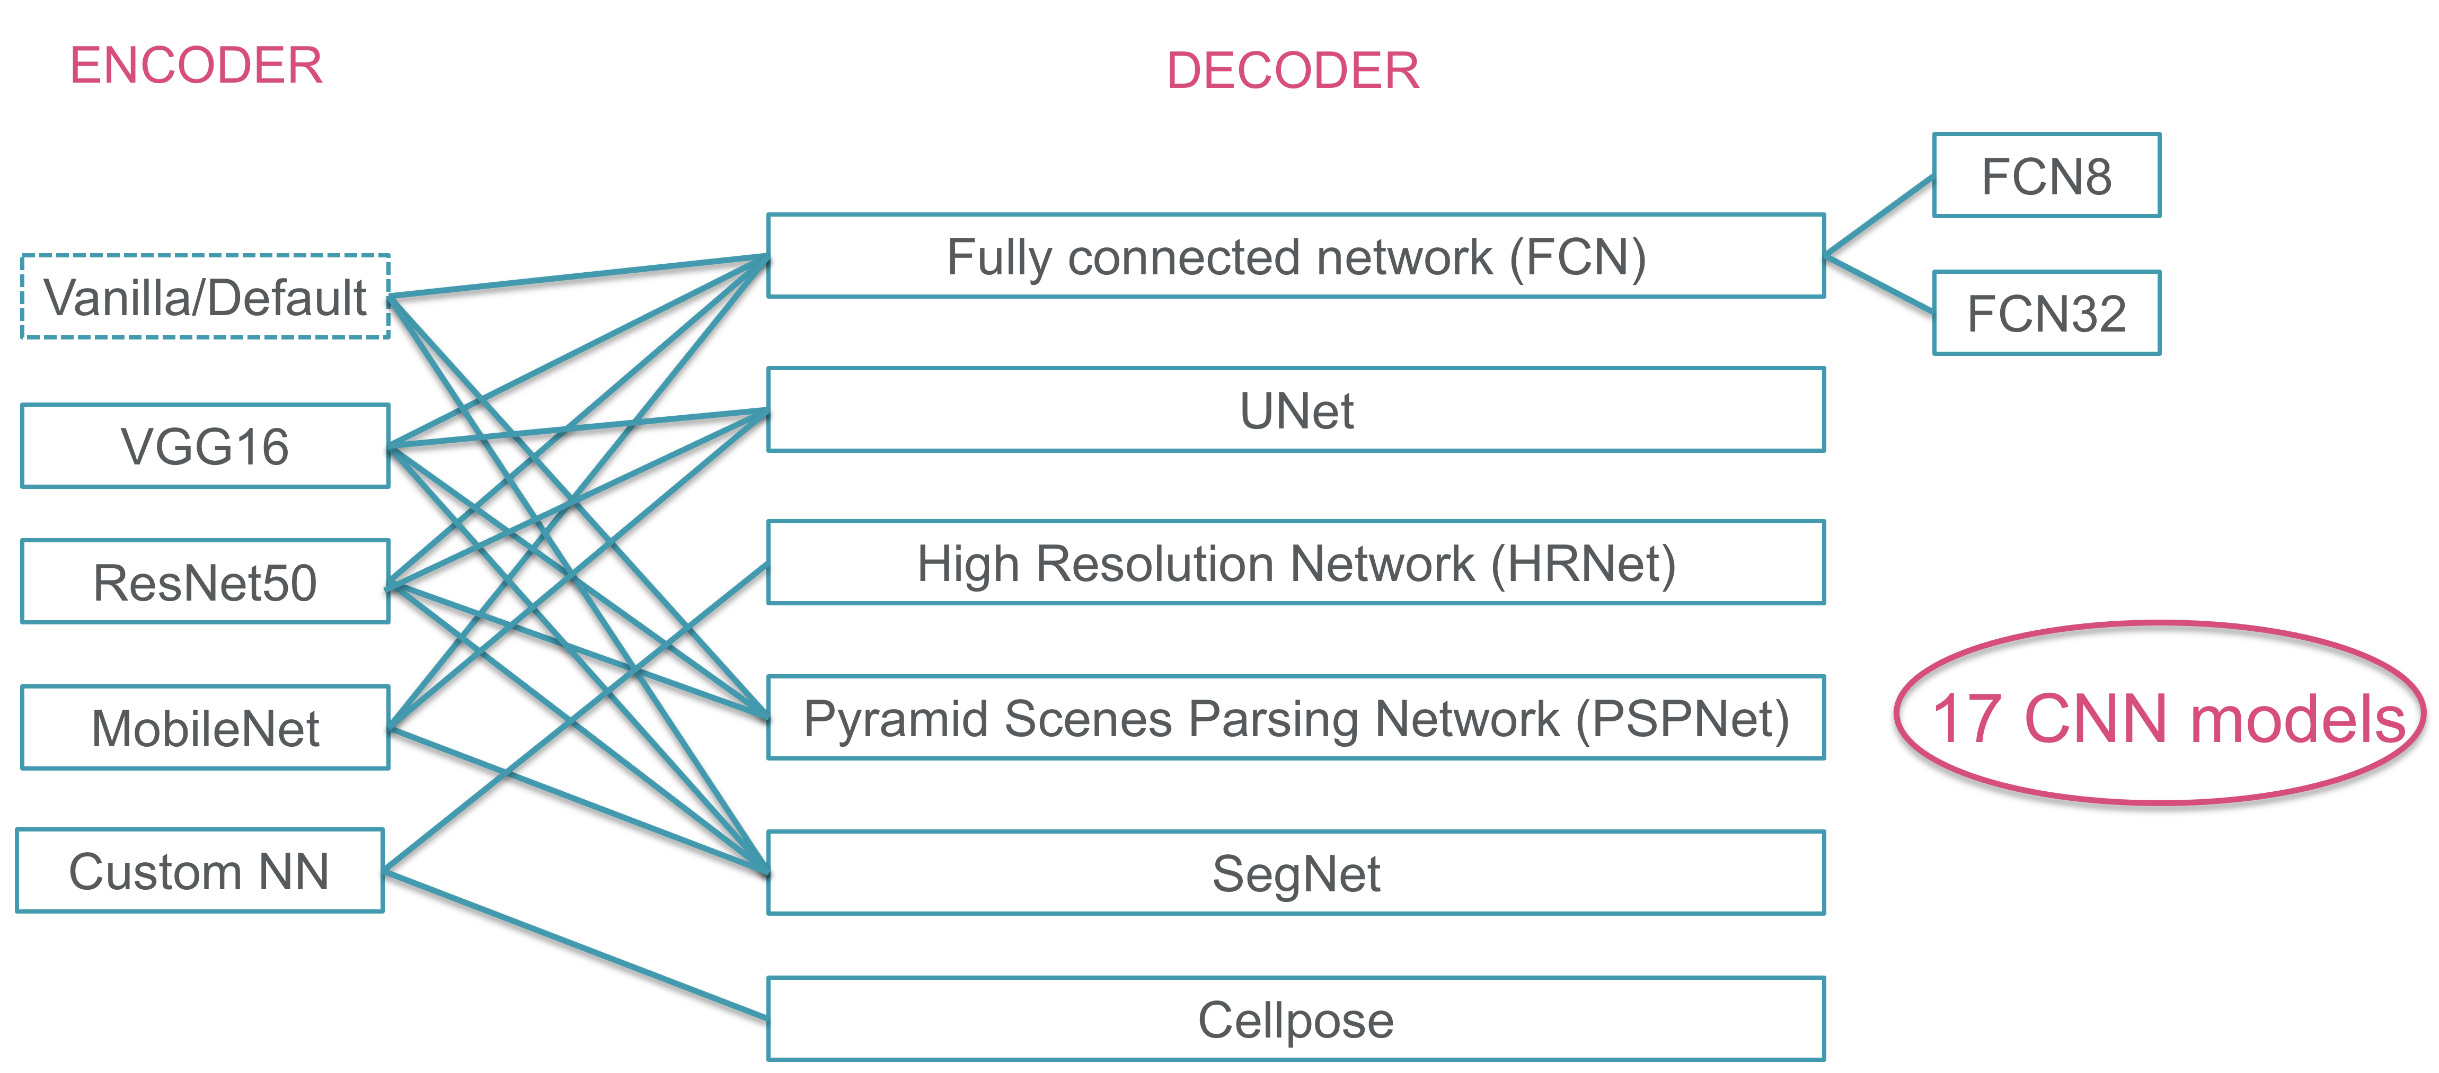
Benchmarking
Encoder
Decoder
State-of-the-Art Deep Learning (DL) segmentation frameworks considered.
Fully Convolutional Networks
U-Net Models
High Resolution Networks
Transformers
Popular Models: DeepLabV3, CellPose
Notes:
State-of-the-Art Deep Learning (DL) segmentation frameworks considered.
Fully Convolutional Networks
U-Net Models
High Resolution Networks
Transformers
Popular Models: DeepLabV3, CellPose

Slide 7
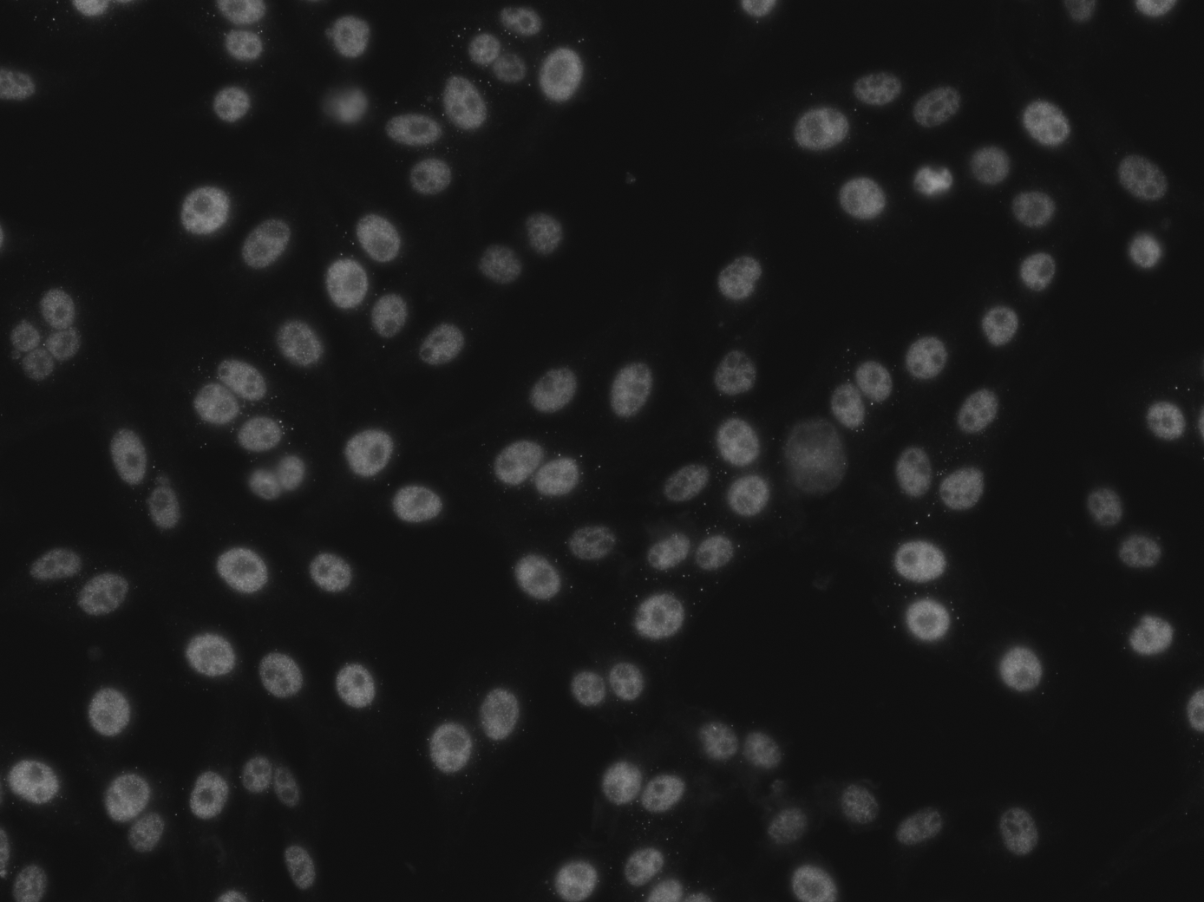
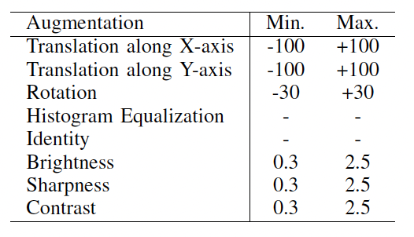
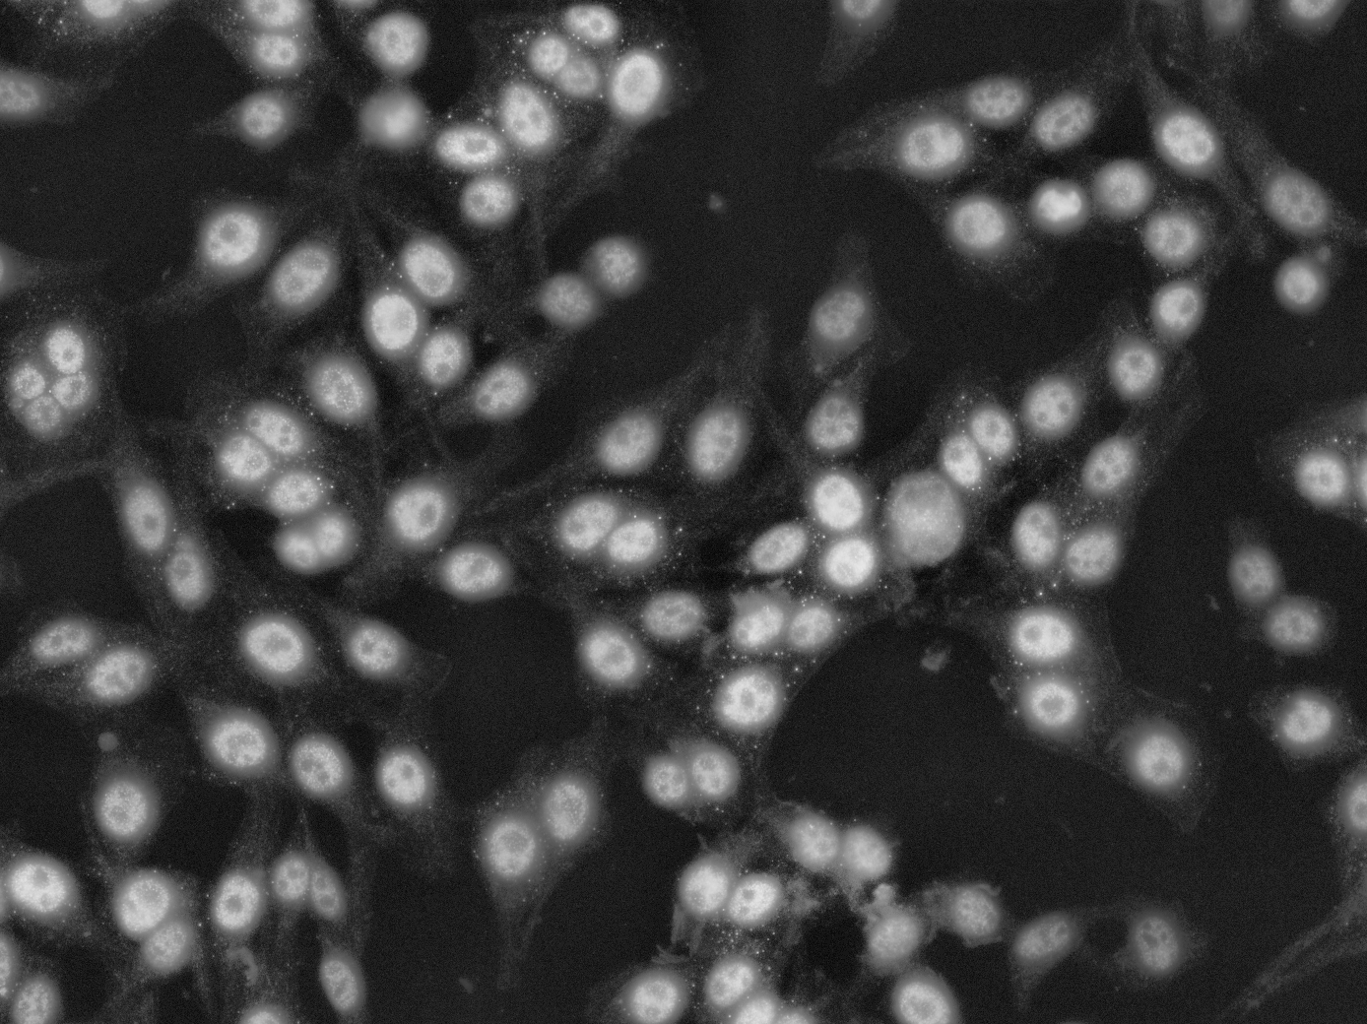
Experiments
Image
GT
AI models
Segmentation
Experiment 1
(17 models)
No pretraining
Experiment 2
(8 models)
Encoder pretraining
Experiment 3
(3 models)
No pretraining OR Encoder pretraining
Data Augmentation
Notes:
Experiment1: Train all 17 Segmentation models on our dataset. The dataset consisted of 3800 images
Experiment 2: For 8 of the 17 models we were able to obtain Encoders that were pre-trained on the ImageNet dataset which contains millions of images from the natural world.
In Expt 3: we considered the 3 top performing models from Expt1 and 2 and applied data augmentation on them.
The main reason behind applying data augmentation was that of the 7 stain patterns present in our dataset 2 were very hard to segment. So we boosted their performance by selectively applying data augmentation.

Slide 8
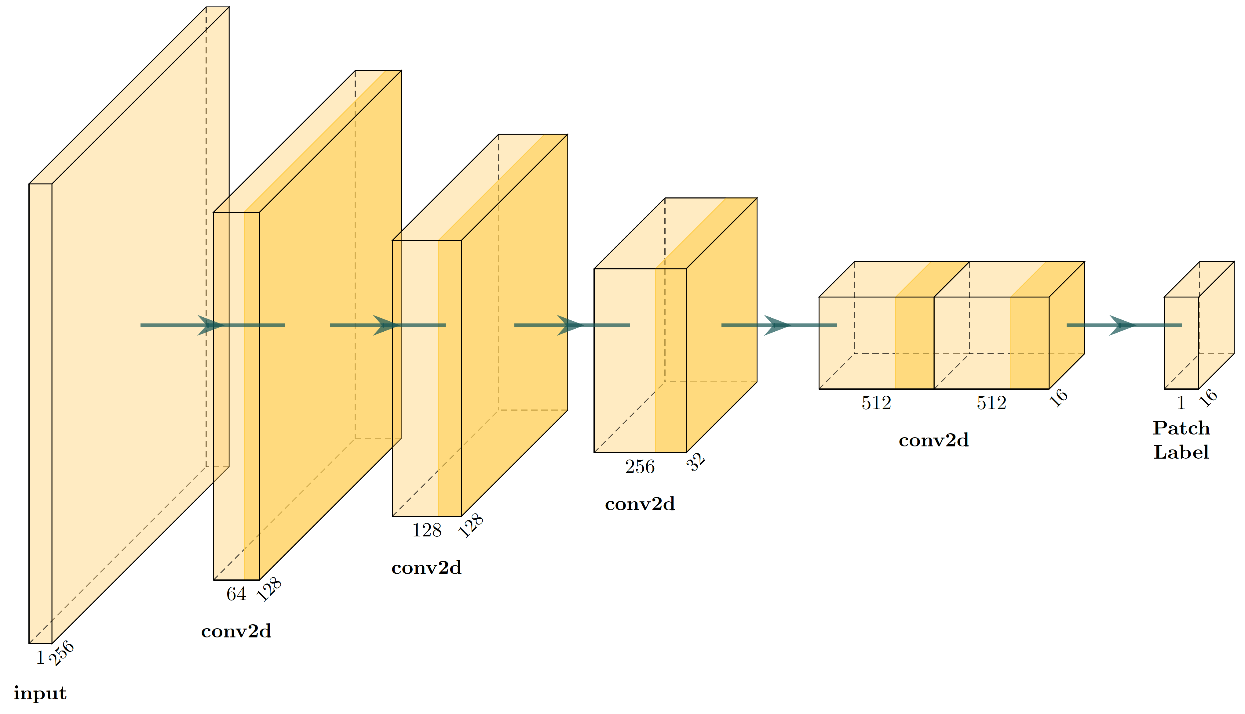
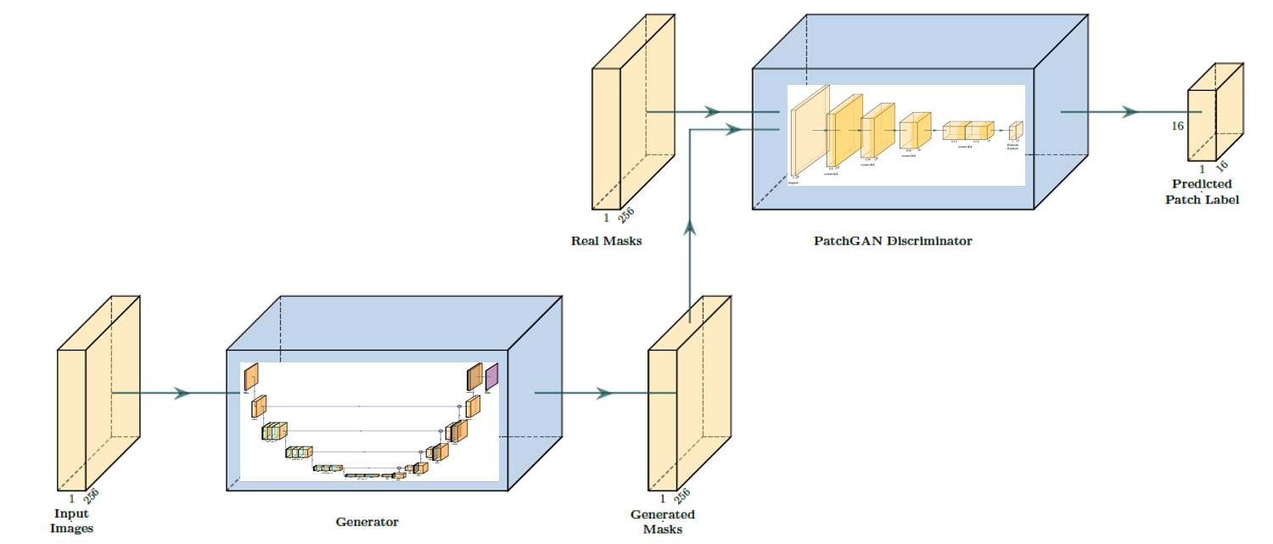
Generative AI
ResNet50-Unet (Generator)
PatchGAN (Discriminator)
pix2pix (GAN)
Notes:
In Experiment 4: We considered once again the Top-3 performing models from Expt 1 and 2 and deployed them in a Generative AI framework.
This gave us an insight into the comparative performance between unaugmented models, augmented models and Generative AI models.

Slide 9
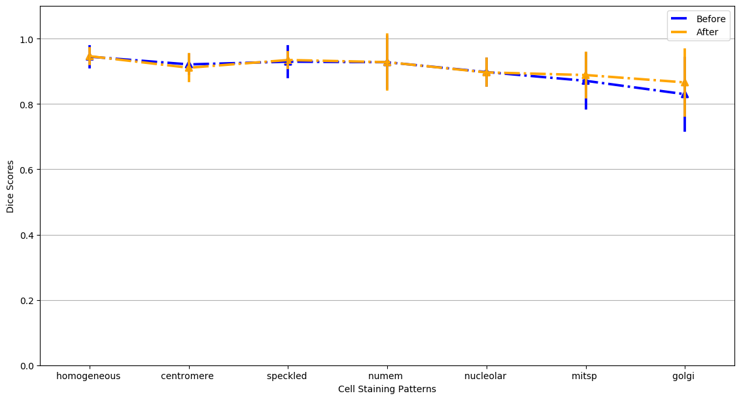
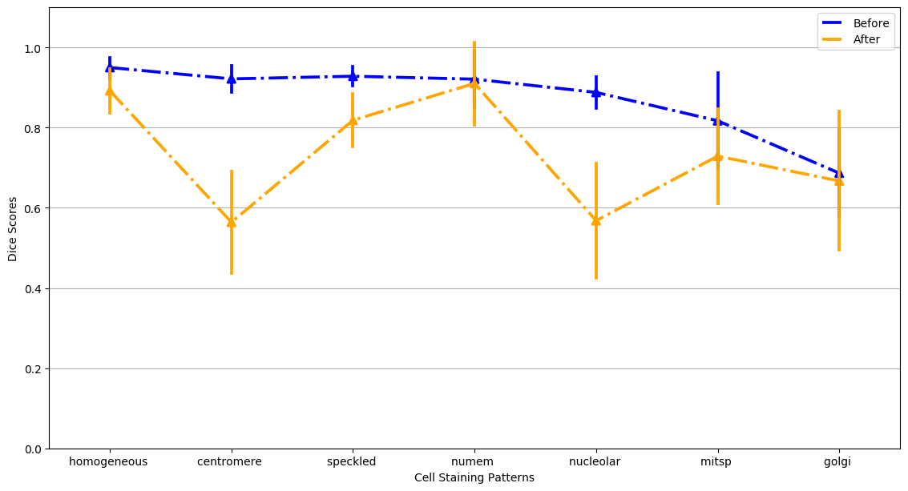
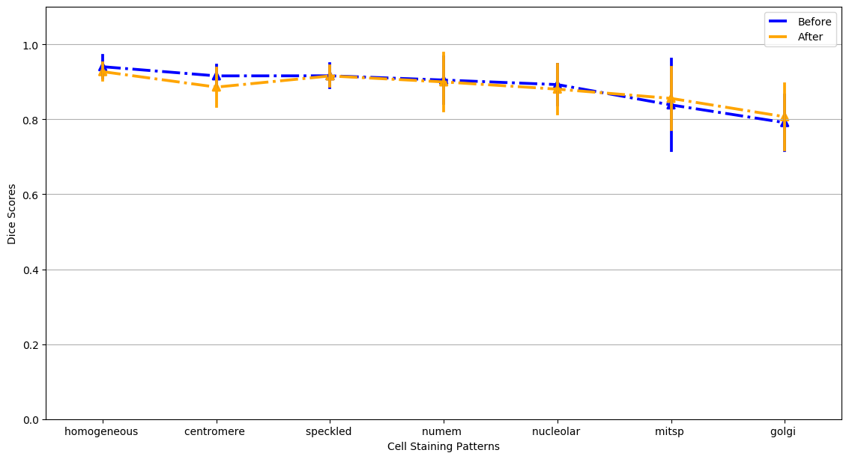
Results
White – TP
Blue – FP
Red – FN
Iyer, Deoghare, Ranjan, Aronow, S. Benchmarking HEp-2 cell segmentation methods in indirect immunofluorescence images – standard models to deep learning, Artificial Intelligence in Medicine, 2023
Notes:
Visually we can see the differences in the performance of Augmented models vs. Unaugmented models.

Slide 10
Results
No | MODEL | ENCODER | DECODER | NOT PRETRAINED CNN (Experiment 1) | PRETRAINED ENCODER CNN (Experiment 2) | AUGMENTED CNN (Experiment 3) | CNN – GAN [not Augmented] (Experiment 4)
1 | FCN32 | Vanilla | FCN32 | 93.7
2 | FCN8 | Vanilla | FCN8 | 95.7
3 | VGG-FCN8 | VGG16 | FCN8 | 96.3 | 93.2
4 | ResNet50-FCN8 | ResNet50 | FCN8 | 96.2
5 | MobileNet-FCN8 | MobileNet | FCN8 | 94.3 | 93.9
6 | PSPNet | Vanilla | PSPNet | 93.9
7 | VGG-PSPNet | VGG16 | PSPNet | 93.6 | 87.9
8 | ResNet50-PSPNet | ResNet50 | PSPNet | 94.7
9 | SegNet | Vanilla | SegNet | 90
10 | VGG-SegNet | VGG16 | SegNet | 90 | 94
11 | ResNet50-SegNet | ResNet50 | SegNet | 95.5
12 | MobileNet-SegNet | MobileNet | SegNet | 84.2 | 95.6
13 | VGG-UNet | VGG16 | UNet | 95.8 | 91.6
14 | ResNet50-UNet | ResNet50 | UNet | 96.3 | 87.8 | (not pretrained) 95.9 | (not pretrained) 95.8
15 | MobileNet-UNet | MobileNet | UNet | 96 | 96.6 | (pretrained) 92.5 | (pretrained) 94.9
16 | HRNet | Custom NN | HRNet | 96.6 |  | (not pretrained) 96.8 | (not pretrained) 93.6
17 | Cellpose | Custom NN | Cellpose | 85
Experiment 1:
No pretraining
Experiment 2:
Pretrained encoder
(Best three from Exp 1&2)
Experiment 3:
Data augmentation
Data 4:
patchGAN discriminator in pix2pix architecture
Metric: Test % accuracy
Notes:
We obtained state-of-the-art results even when compared to Cellpose !
We were able to improvement in performance was noted in many cases.

Slide 11
Conclusion
Successfully trained multiple CNN, GAN and Transformer based segmentation models capable of discerning 7 cell staining patterns.
Introduced Novel neural network architectures that outperformed existing models in this domain.
Studied effect of model pretraining under different conditions. Found domain specific pretraining to be more effective.
Introduced novel data augmentation techniques. Hard to segment classes like Golgi and Mitotic Spindle benefit massively using these methods.
Analyzed the quantitative and qualitative performance of Generative AI models across each staining pattern. In contrast to CNN models, GAN’s are limited by the dataset size.
Currently in the process of releasing these models and code publicly.
Notes:
Successfully trained multiple CNN, GAN and Transformer based segmentation models capable of discerning 7 cell staining patterns.
Introduced Novel neural network architectures that outperformed existing models in this domain.
Studied effect of model pretraining under different conditions. Found domain specific pretraining to be more effective.
Introduced novel data augmentation techniques. Hard to segment classes like Golgi and Mitotic Spindle benefit massively using these methods.
Analyzed the quantitative and qualitative performance of Generative AI models across each staining pattern. In contrast to CNN models, GAN’s are limited by the dataset size.
Currently in the process of releasing these models and code publicly.

Slide 12
Team
Balaji Iyer
Division of Biomedical Informatics, Cincinnati Children’s Hospital Medical Center
Department of Computer Science, University of Cincinnati
iyerbs@mail.uc.edu
Dr. Bruce Aronow
Division of Biomedical Informatics, Cincinnati Children’s Hospital Medical Center
Department of Computer Science, University of Cincinnati
Department of Pediatrics, University of Cincinnati
Smruti Deoghare
Division of Biomedical Informatics, Cincinnati Children’s Hospital Medical Center
Department of Biomedical Informatics, College of Medicine, University of Cincinnati
Dr. Surya Prasath
Division of Biomedical Informatics, Cincinnati Children’s Hospital Medical Center
Department of Computer Science, University of Cincinnati
Department of Pediatrics, University of Cincinnati
Krish Ranjan
Division of Biomedical Informatics, Cincinnati Children’s Hospital Medical Center

