Slide 1
Advancing Healthcare Innovation Summit (AHIS) 2023, Virtual Event November 11, 2023
AI-driven Gait Parameters Estimation from Videos for Cerebral Palsy Patients
Presented By: Balaji Iyer
Notes:
Hello Everybody, first of, I thank the organizers of AHIS for this wonderful conference and this opportunity to present our research work.
The topic of my presentation is “AI-driven Gait Parameters Estimation from Videos for Cerebral Palsy Patients”

Slide 2
Introduction
Cerebral Palsy (CP) is a motor dysfunction caused by brain injury or brain malformation in utero or before or after birth.
May affect both limbs symmetrically or asymmetrically.
Wide variance in severity observed.
It is clinically important to objectively evaluate gait function in patients with this kind of motor dysfunction.
Notes:
In the US alone, more than 1 million people of all ages suffer from Cerebral Palsy
Globally, that number is about 18 million people.
Cerebral Palsy is a motor dysfunction caused by brain injury or brain malformation.
It can occur in utero, before birth or after birth.
May affect both limbs symmetrically or asymmetrically
It severely affects Quality of life
Early detection of Cerebral Palsy and correct treatment protocols are critical and can lead to improved outcomes for patients.

Slide 3
Introduction
Gait assessment done in highly sophisticated Gait Lab under expert supervision.
Patients are made to perform specific movements.
Gait parameters are estimated using optical motion capture systems and other sensors attached to various positions on the patient's body.
It is clinically important to objectively evaluate gait function in patients with this kind of motor dysfunction.
Expensive, time consuming, requires highly-equipped motion lab and experts
Notes:
Typically, Gait Assessment is done in a Gait lab.
These labs have a sophisticated setup with multiple cameras, controlled environment, data capturing and processing devices and several experts in different domains.
Patients are made to perform specific movements under expert supervision.
Their kinematic data is captured using motion capture systems and other sensors
Obviously Such assessments are expensive, time consuming and resource intensive.

Slide 4
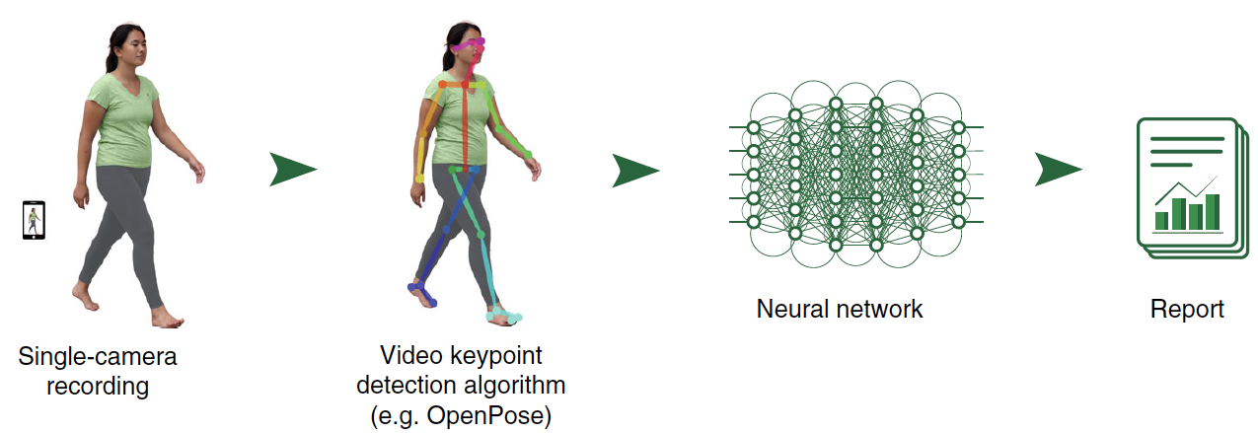
Introduction
Research Question: Can we leverage artificial intelligence (AI) to replicate this process using cell phone cameras ?
Significance: Monitoring gait parameters at regular intervals can improve patient outcome while reducing treatment costs.
Goal: AI based estimation of spatiotemporal parameters like gait deviation index (GDI), observational gait score (OGS), Symmetry etc. from low-resolution commodity camera videos
Notes:
To overcome these challenges, we ask the research question can we leverage Artificial Intelligence to replicate/approximate this process using low resolution cell phone videos.
Monitoring gait parameters at frequent intervals can improve the triaging process for these patients, leading to early interventions when required.
The Objective of this study is to estimate spatiotemporal parameters like gait deviation index (GDI), observational gait score (OGS), Symmetry etc. from low-resolution videos

Slide 5
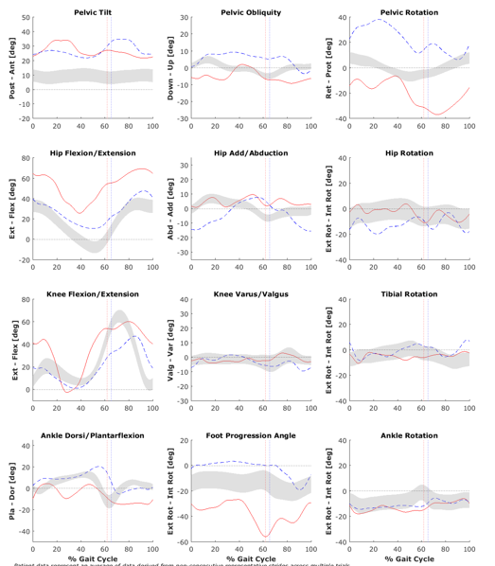
Gait Parameters
Simple Spatiotemporal Parameters: Stride Length, Walking Speed, Cadence, Stance Duration
Kinematic Parameters: Knee Flexion Angle, Pelvic Tilt, Hip Flexion etc.
Computed Parameters: Gait Deviation Index (GDI). Range: 0 – 100. Higher scores indicates unimpaired gait. Computed from Kinematic Parameters
Clinical Parameters: Scores provided by clinical experts based on visual observation. Example: Observational Gait Score (OGS). Range: 1 – 22. Higher scores indicate unimpaired gait.
Notes:
Gait Parameters come in many different flavors. The simpler ones are more familiar to all of us who use SmartWatches or Fitness Apps.
Kinematic Parameters like knee flexion angle are measured in Gait Lab and are used for computing higher level parameters like Gait Deviation Index abb. as GDI
GDI ranges from 0-100 with higher scores indicating unimpaired gait.
There are many Clinical Scores as well such as Observational Gait Score or Edinburgh Scale. These scores are provided by clinical experts based on visual observation. OGS for example is an integer score that ranges from 1-22. with higher scores indicate normal gait.

Slide 6
Contributions
Data Collection: Developed specific protocol. 86 patients recruited for study.
Annotation: Each patient video assessed by clinical expert providing OGS score as well as symmetry score.
Data Pipeline: Developed custom data processing pipeline for analyzing the videos.
AI Modeling: Developed Deep Learning based A.I model to estimate the limb specific OGS score and symmetry for each patient.
Notes:
Our main contributions in this study are
1.

Slide 7
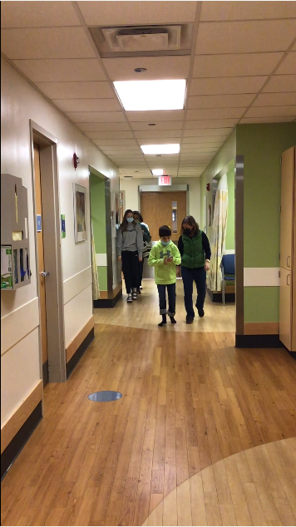
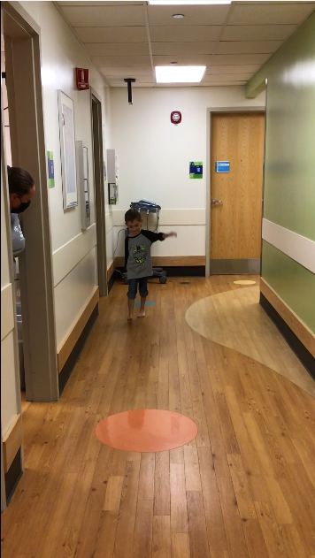
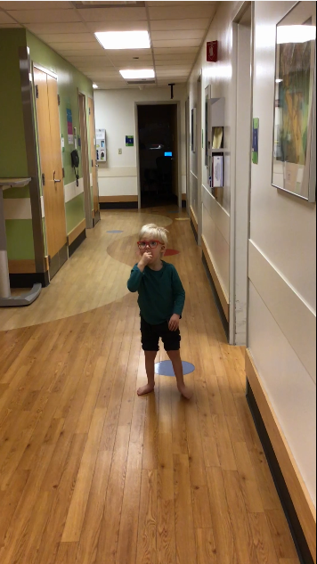
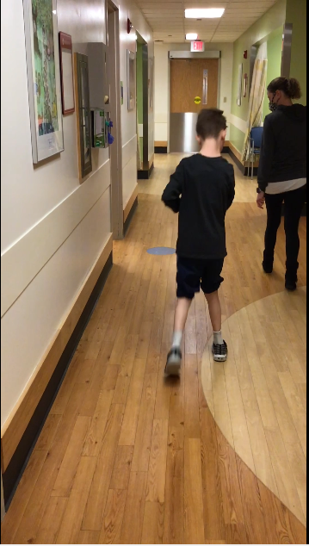
Challenges
Pediatric patients: Need human assistance. Don’t follow commands
Some require assistive devices
Background Distractors: Most videos are multi-person instead of a single person present
Videos capture Anterior-Posterior views rather than Lateral view
Notes:
We faced some really interesting challenges during the data collection process.
Repeat point 1
Point 2
Point 3
During the literature review process, we found that similar works used lateral view videos instead of Anterior/Posterior views. This is because AP views carry lesser information about the knee flexion angle compared to Lateral Views.
Knee Flexion Angle is one of the most important parameters while estimating gait normalcy.

Slide 8
Pipeline
Cell Phone Videos
Person Tracking
Manual Curation
Keypoint Extraction
Observational Gait Score
AI Model
Filtering & Feature Addition
Cell Phone Videos
Person Tracking
Manual Curation
Keypoint Extraction
Filtering & Feature Addition
AI Model
Observational Gait Score
Observational Gait Score Prediction

Slide 9
Person Tracking
Manual Curation
Clean videos: Retain patient and remove other persons in video
Deployed State-of-the-Art FairMOT A.I model
Track individuals present in each frame of video
Identify person-of-interest in each video
Remove background distractors
Cell Phone Videos
Person Tracking
Manual Curation
Keypoint Extraction
Filtering & Feature Addition
AI Model
Observational Gait Score
Observational Gait Score Prediction
Notes:
In the video on the left, you can see a person standing in the background.
Presence of these distractors can lead to erroneous performance from AI models.
To remove them, we first track each individual in every frame of the video. This was done using the State-of-the-Art A.I model known as FairMOT.
The video on the right shows the result after removing these distractors.

Slide 10
Keypoint Extraction
Videos: Low Signal-to-Noise Ratio.
Directly applying A.I model results in extremely poor performance.
Keypoints of persons carry most signal and less noise
Experimented with Several Models: BlazePose, AlphaPose and HR-Net.
BlazePose works best and detects 25 keypoints in body.
Cell Phone Videos
Person Tracking
Manual Curation
Keypoint Extraction
Filtering & Feature Addition
AI Model
Observational Gait Score
Observational Gait Score Prediction

Slide 11
Filtering & Feature Addition
Remove Noise in Signals
Compute Higher Semantic Features: Knee Flexion Angle, Valgus/Varus Angle etc.
Left Knee X
Left Knee Y
Left Ankle X
Left Ankle Y

Slide 12
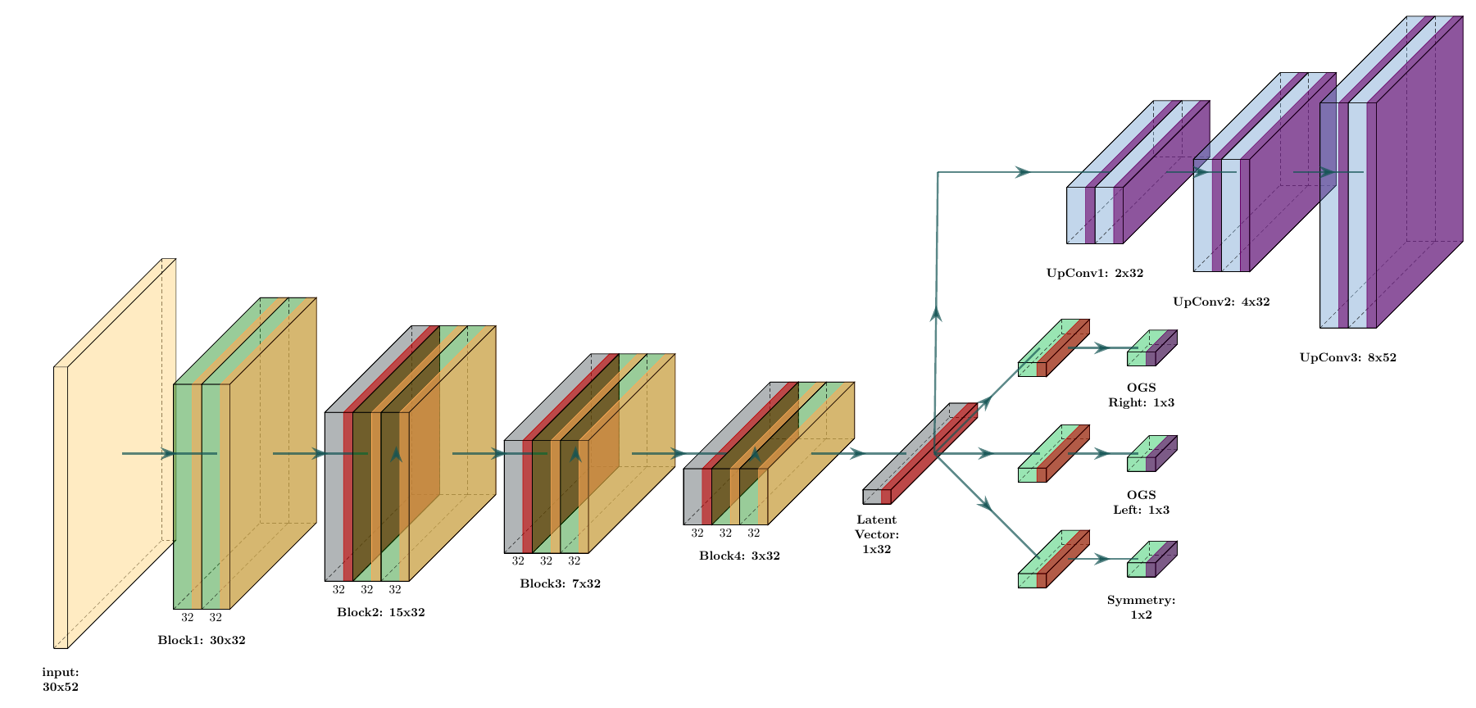
AI Model
Input: 30x52 data matrix.
Each input captures 30 frames containing 52 signals in every frame.
Output: Left-OGS, Right-OGS and Symmetry (0/1)
Collapsed OGS score into 3 classes.
Model is pre-trained by forcing it to predict future signals in the same video.
Training done on dataset of 54 patients.
Testing on 20 patients.

Slide 13
Results
 | Accuracy | Precision | Recall
OGS Right | 0.64 | 0.55 | 0.60
OGS Left | 0.61 | 0.53 | 0.56
Symmetry | 0.69 | 0.60 | 0.55

Slide 14
Conclusion
Overcame several Challenges
Good Results despite Limited Data
Lack of Information in AP view compared to Lateral view.
Presence of Background Distractors
Use Open-source A.I Models: Several failure cases in case of pediatric subjects
Cell Phone Videos
Person Tracking
Manual Curation
Keypoint Extraction
Filtering & Feature Addition
AI Model
Observational Gait Score
Observational Gait Score Prediction

Slide 15
Team
Balaji Iyer
Division of Biomedical Informatics, Cincinnati Children’s Hospital Medical Center
Department of Computer Science, University of Cincinnati
iyerbs@mail.uc.edu
Dr. Bruce Aronow
Division of Biomedical Informatics, Cincinnati Children’s Hospital Medical Center
Department of Computer Science, University of Cincinnati
Department of Pediatrics, University of Cincinnati
Dr. Surya Prasath
Division of Biomedical Informatics, Cincinnati Children’s Hospital Medical Center
Department of Computer Science, University of Cincinnati
Department of Pediatrics, University of Cincinnati
Gait Team
Division of Biomedical Informatics, Cincinnati Children’s Hospital Medical Center
Division of Occupational Therapy, Cincinnati Children’s Hospital Medical Center

